Slide 1

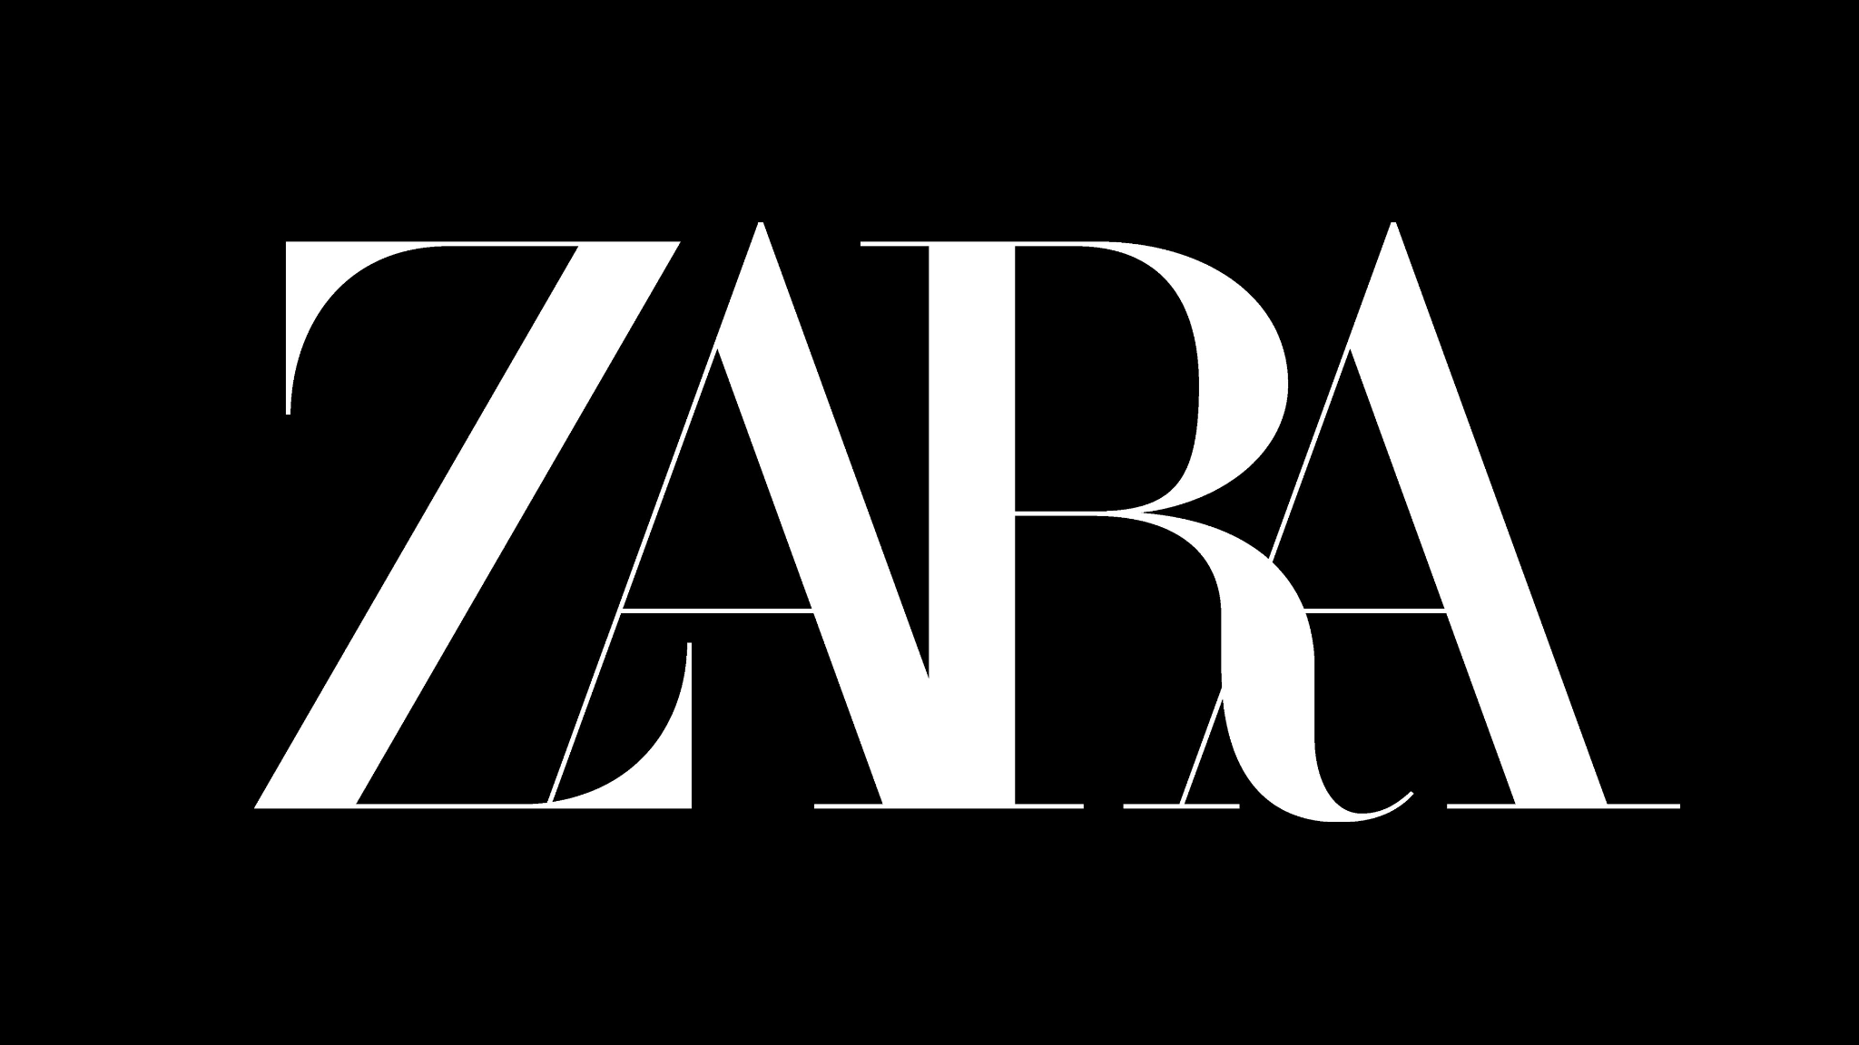
VS
Class 2, Group 3

Slide 2
CONTENTS
INTRODUCTION
FIRST QUESTION
SECOND QUESTION
THIRD QUESTION
FOURTH QUESTION
FIFTH QUESTION
00
01
02
How attractive is the apparel industry?
What is Zara’s business model, and how did it evolve with digitalization?
03
04
05
What is SHEIN’s business model, and what is the role of digitalization in SHEIN’s business model?
How would you compare the two business models, and how are the two groups successful in the market?
What should SHEIN do in its future strategy?

Slide 3
INTRODUCTION

Slide 4

ABOUT ZARA
Zara is a Spanish multinational retail enterprise created in 1975, initially called Zorba.
One of the most profitable apparel enterprises in the market nowadays and one of the pioneers of the called fast-fashion.

Slide 5
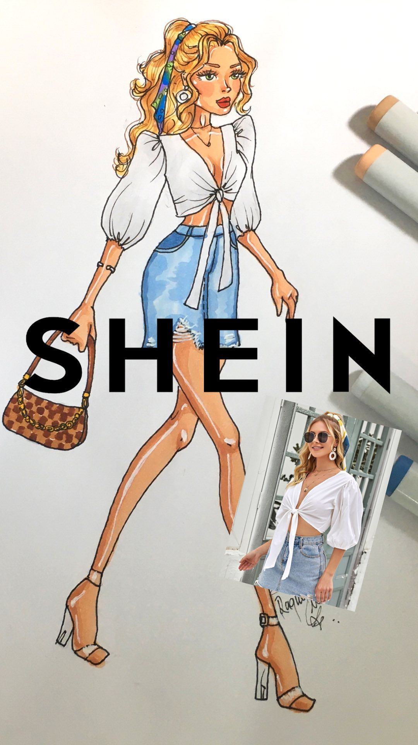
ABOUT SHEIN
SHEIN is a Chinese enterprise, B2C fast fashion e-commerce platform, focused mainly in women wearing. SHEIN’s concept is: “everyone can enjoy the beauty of fashion!”.
SHEIN began as a wedding dress seller and rapidly expanded its products to general apparel in worldwide scale.
With a great business model, it quickly became profitable.
Notes:
SheIn was also initially called “SheInside”. This rebrand made SHEIN more memorable and searchable for shoppers.

Slide 6
PROBLEM IDENTIFICATION
Despite SHEIN’s exponential growth in the previous few years, some problems have been raised lately:
Product quality, as well as receiving products that were the wrong size or the wrong fit;
SHEIN was also criticized for products that were culturally inappropriate and insensitive;
Given the affordable prices of products, how SHEIN could possibly make money?
Lack of transparency about its activities.
Concerns about environmental impact caused by the fast-fashion industry
Like other Chinese brands, SHEIN faced political risks in the international market.
Taking that into account, the main question that we will explore and try to answer in the best way possible is: What should SHEIN do in its future strategy in order to in order to solve and overcome the problems described above?

Slide 7
QUESTIONS

Slide 8
FIRST
QUESTION
SUPPLIER POWER
Several suppliers;
Have the power to influence price, as well as the availability of resources/inputs;
Are most powerful when companies are dependent on them and cannot switch to other suppliers;
Relatively small and insignificant force in apparel industry.
How attractive is the apparel industry?
COMPETITIVE RIVALRY
Large numbers of retailers who sell very similar products;
Market is quickly becoming saturated with very similar products;
THREAT OF SUBSTITUTION
There is little to substitute clothes with, but every brand has several competitors;
There are substitutes that can make high-end styles available at lower prices.
THREAT OF NEW ENTRY
High investment is necessary to adapt to the digitalization model;
Low entry barriers, but it’s difficult to build a great reputation.
BUYER POWER
Buyers can choose to push down prices, not buy products, or switch retailers;
Customers are well-informed, can choose from several alternatives, and can switch easily between the several brands in the market;
Customers force brands the necessity to adapt to new trends;
Websites and apps have become indispensable.
Notes:
Competitive Rivalry: high risk
Supplier Power: low risk
In the fashion retail industry, supplier power is a relatively small and insignificant force. Most apparel companies source their products from third world manufacturers who receive just fractions of the profit. Suppliers have little control over the fashion industry as, unfortunately, they are dispensable and can always be swapped out.
Buyer Power: high risk
Threat of New Entry: medium-low risk
It’s easy to entry, but difficult to build a great reputation and compete with well-known brands.
“High Risk, Low Reward”
Threat of Substitution:
low risk, if we look at it from the perspective of the clothes themselves;
high risk, if we look at it from the perspective of brands, as they all have several competitors and a brand can create new products with lower prices or better quality and substitute another.
This Five Forces analysis has shown that while there are few threats and little supplier bargaining power, it is not good that the market is effectively nearing saturation. Buyers have large amounts of indirect power to bargain with and lots of competitors make it hard to sustain a place in the market.

Slide 9
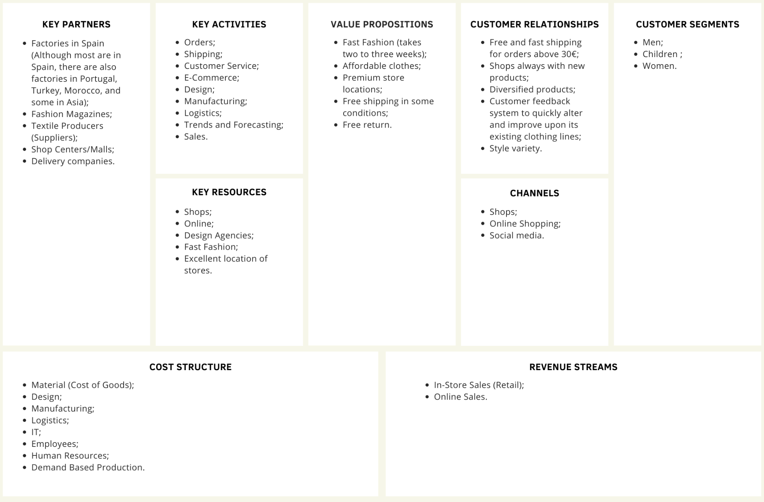
SECOND
QUESTION
What is Zara’s business model, and how did it evolve with digitalization?

Slide 10
SECOND
QUESTION
COMPUTERIZED
TARGETING
HIGH VARIETY
E-COMMERCE
FAST-FASHION
SMALL BATCHES
What is Zara’s business model, and how did it evolve with digitalization?
Computerized inventory management and collected data from sales.
Allowed targeting customer regions and segments, making specific designs for specific countries/stories.
All these methods the creation of a high variety of products
Created e-commerce, which improved the data analysis and fast fashion model.
The data allowed Zara to create a design and a production cycle of 3 weeks for each product.
Allowed the production of small batches that reduced the costs and storage loss.
Notes:
Zara was the pioneer at creating a BM that computerized inventory management and collected data from sales.
They were the pioneers of fast-fashion, which was only allowed through computerized management, which made them evolve into one of the most relevant and unique companies in the apparel industry.
The computerized inventory management allowed Zara to target specific customer regions and segments, making specific designs for specific countries/stores
This also allowed Zara to create a design and production cycle of 3 weeks for each product, producing low batches of 300-500 pieces, reducing losses from inventory
All this methods allowed reduced costs of production and high variety of products with a high refresh rate (2 to 3 weeks)
The made people go often to the stores, check for new apparel and impulse buy products
Also, digitalization allowed Zara to build an e-commerce platform, which increased their capability to collect data and improve their fast fashion model.

Slide 11
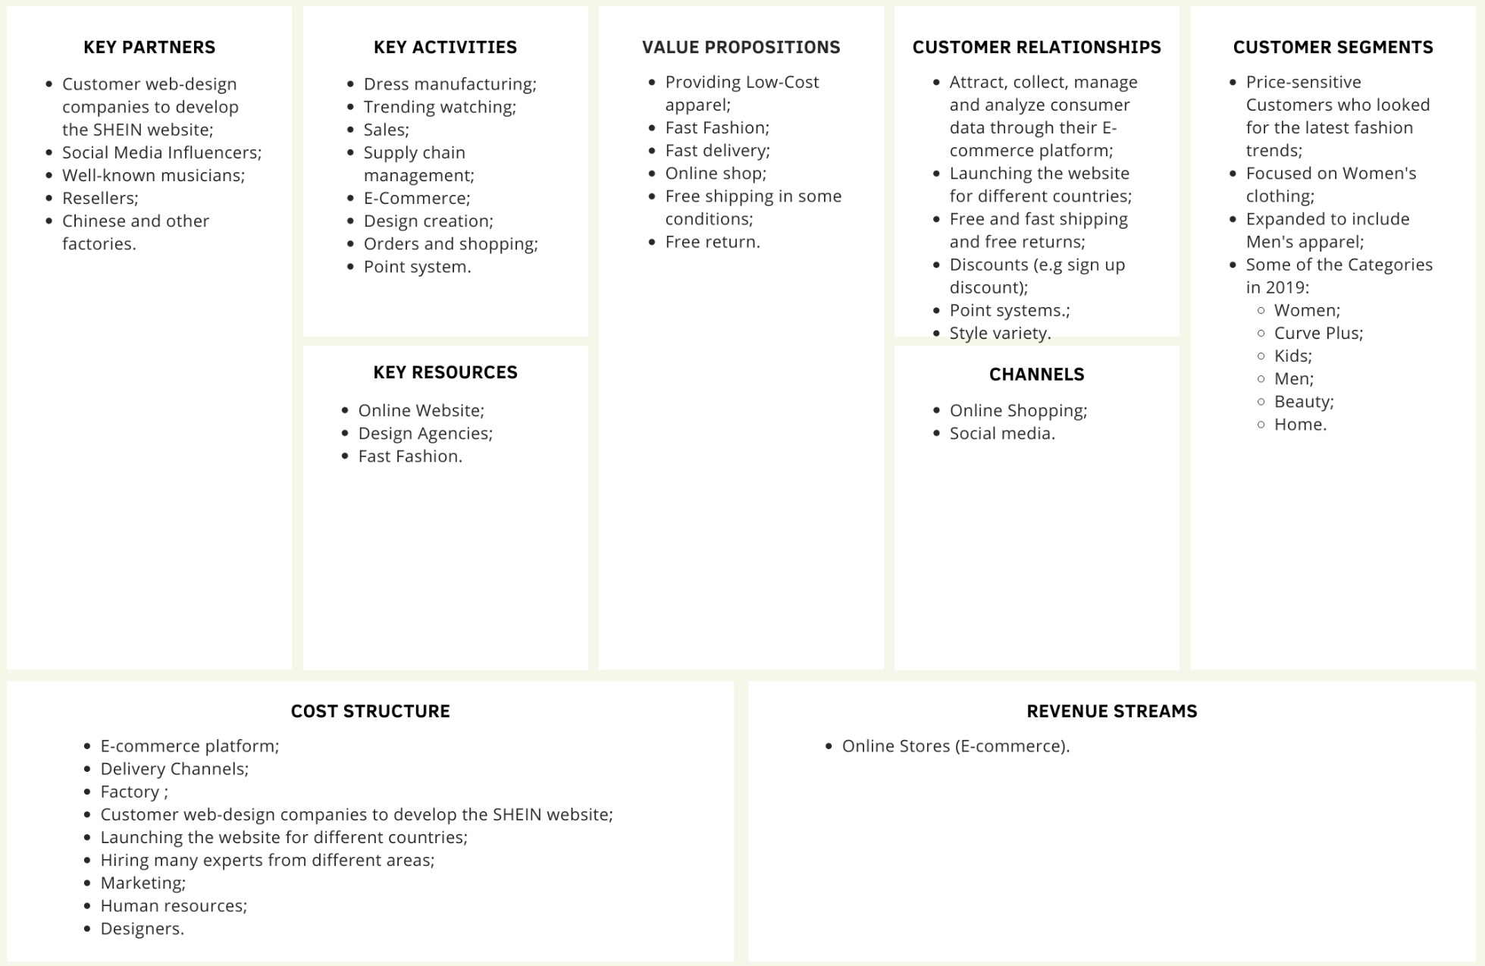
THIRD
QUESTION
What is SHEIN’s business model, and what is the role of digitalization in SHEIN’s business model?

Slide 12
THIRD
QUESTION
ONLINE-ONLY
FAST FASHION
LIVE ANALYSIS
What is SHEIN’s business model, and what is the role of digitalization in SHEIN’s business model?
Thus, the digitalization plays a major role, by reducing physical costs and allowing live analysis.
The live analysis allows the fast production of new design and therefore speed up the production cycle
A “real-time” way to perform data analysis, which makes them predict and catch trends.
Notes:
Given SHEIN is an online-only company, digitalization plays a major role in its business model. In addition to that, the absence of a physical store reduces maintenance costs.
Given SHEIN is digital, they have almost a “real-time” way to perform data analysis with access to more information than just “what people bought at what store”
This makes them predict and catch on trends at a really high pace, targeting specific consumers and regions.
This allows SHEIN to have new designs crafted within as little as 3 days, building an innovative ultra fast-fashion business model.

Slide 13


FOURTH
QUESTION
CUSTOMER SEGMENTS
VALUE PROPOSITION
SHEIN focuses on women’s clothing, although they have expanded to also provide apparel for men and kids;
SHEIN aims at Gen Z, young people that look for affordable fashion in order to keep up with their peers and social media trends;
Zara has a less price-sensitive customer base, also aiming at medium-high income consumers that wish to keep up with fashion.
Both companies uses fast-fashion, but SHEIN adds more diversity by performing the fast-fashion cycle in less time;
Free shipping under certain conditions;
Both companies have free return policies;
Zara stores are accessible at a premium location;
SHEIN manages to be 3 or 4 times cheaper than Zara;
Both companies have fast delivery.
How would you compare the two business models, and how are the two groups successful in the market?

Slide 14
FOURTH
QUESTION
CHANNELS
CUSTOMER RELATIONSHIPS
Both companies can bring their products through an online delivery service after purchasing a set of items on their E-commerce platforms;
Zara has physical stores in premium locations to display and sell its products;
SHEIN has free shipping on orders above 9.90€, while Zara does it on orders above 30€;
Both companies are cheap, but SHEIN manages to be 3 to 4 times cheaper than Zara;
SHEIN provides more variety of styles;
SHEIN offers discounts for new users, making the adhesion easier, and also a point system;
Zara’s shipping takes 2-4 working days, while SHEIN shipping takes 12-18 days.
How would you compare the two business models, and how are the two groups successful in the market?
Notes:
SHEIN’s shipping time and costs heavily depend on the location.
SHEIN: If an express shipping method is applied, the delivery is slightly faster at an additional cost.

Slide 15
FOURTH
QUESTION
REVENUE STREAMS
KEY ACTIVITIES
Both companies profit from selling apparel;
SHEIN does it exclusively online, while Zara has physical stores.
Both companies approach the market with a fast-fashion business model;
Given that SHEIN is fully digital, they have almost a “real-time” way to perform data analysis with access to more information than just “what people bought at what store”;
Therefore, SHEIN’s new designs can be crafted within as little as 3 days, while in Zara, the process takes 2 to 3 weeks;
The main difference is that SHEIN is exclusively Digital with its E-commerce platform, while Zara also has physical stores.
How would you compare the two business models, and how are the two groups successful in the market?
KEY RESOURCES
SHEIN only uses its online store to sell its products, while Zara also has physical stores.

Slide 16
FOURTH
QUESTION
KEY PARTNERS
COST STRUCTURE
Zara has partnership with shopping/malls to have their stores in a premium location, while SHEIN doesn’t;
SHEIN cultivates relationships with Chinese factories and manufacturing. Zara has its own factories;
SHEIN approaches partnership with influencers.
Both companies have costs associated with manufacturing, clothing and web design, delivery channels, and platform maintenance;
Zara has additional costs associated with its physical stores and owns their own factories, while SHEIN does not have them.
How would you compare the two business models, and how are the two groups successful in the market?
Notes:
SHEIN has reduced costs in their structure, which enables them to sell cheaper apparel while keeping a high-profit margin;
Even though they don’t have their own factories, they can maintain low costs due to:
Cheap labor in Asian countries
Partnerships with small to medium-sized factories, which give SHEIN more bargaining power for lower prices
Also, given their BM is so fast, they can start producing low batches of under 100 pieces for a single product and quickly increase the demand if the product gets viral overnight. This also allows them to withdraw a product from the market with minimal losses

Slide 17

FOURTH
QUESTION
How would you compare the two business models, and how are the two groups successful in the market?
Accessible prices and available discounts
High variety of products due to the fast-fashion
Customer data analysis, to catch and understand the late trends
Fast delivery and easy access to the clothes (online and premium locations)

Slide 18
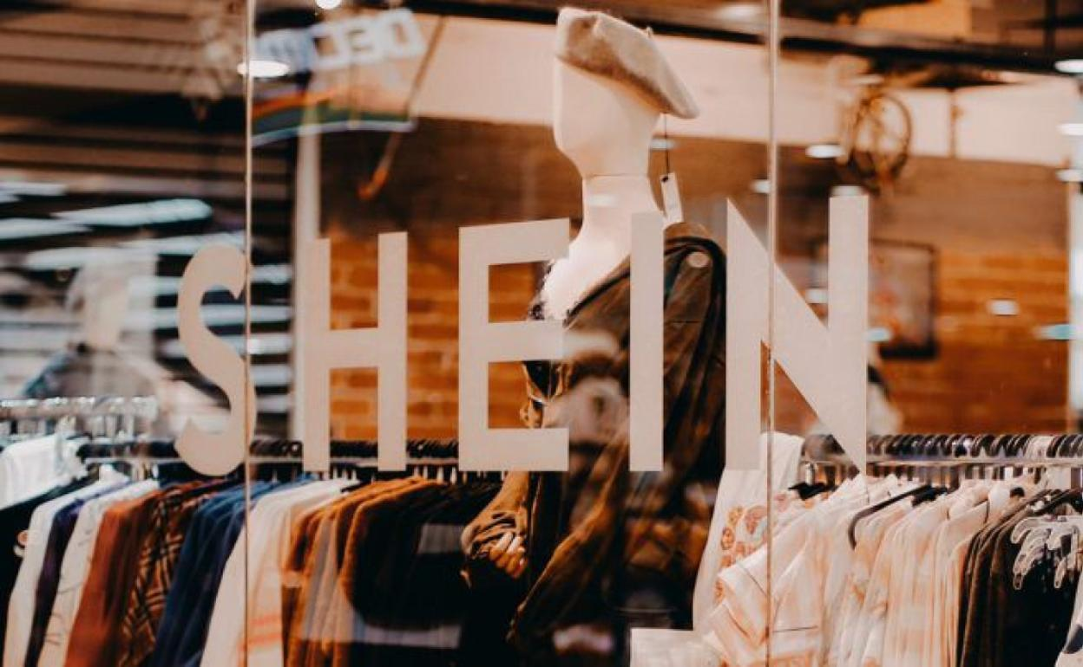
FIFTH
QUESTION
Improve the marketing and investment regarding cosmetics, by using the social network to promote their products. Recently, the enterprise has increased the number of purchases in this area, as they went viral due to having a good quality while maintaining low and accessible prices.
What should SHEIN do in its future strategy?
Include higher quality products to reach customers with higher standards. The main reason for this is that most of the actual clients are from an early generation that could improve their spending standards over time.
Expanding its presence in the Chinese market might not be a lucrative alternative to the enterprise. Clothes that might seem cheap to Europe, for example, don't look so attractive to the Chinese population, due to over-saturated cheap apparel marketing, that are present not only online, but also with physical stores. Also, it would be necessary to compete with well established enterprises in China, such as Uniqlo.

Slide 19
FIFTH
QUESTION
SHEIN could work on strategies to increase its transparency to improve customer perception, since one of the most outlined problems is its deficit in transparency. For instance, SHEIN did not give details about the manufacturing process of its products. Investing in a more positive customer perception could also be a way to try to mitigate sabotage campaigns that are more common nowadays in social media.
Still, a way to improve the brand image of the company, would be to approach the sustainability concerns related to the enterprise. This not only would ease the criticism, but also would decrease the impact of future sanctions to be imposed by the government of the biggest markets, such as the US.
What should SHEIN do in its future strategy?

Slide 20
THANK YOU!
Class 2, Group 3
Allan Sousa, up201800149
Breno Pimentel, up201800170
Carolina Guilhermino, up201800171
Juliane Marubayashi, up201800175
Hugo Guimarães, up201806490
Pedro Ponte, up201809694

